Slide 1
NE 795: Advanced Reactor Materials
Fall 2023
Dr. Benjamin Beeler

Slide 2
Exam Results
Avg: 92.25 ; added a 2.75 point curve

Slide 3
Last Time
Constituent redistribution in UZr
thermodynamic and Soret diffusion effects
Different porosities in different phases
Thermal conductivity degrades with porosity, but increases with sodium infiltration
Fuel cladding mechanical and chemical interaction
FCMI limited by low smear density and large plenum
swelling due to fission gas and solid fission products
FCCI is a complex thermodynamic and kinetic process
low melting phases can be studied with diffusion couples

Slide 4
Paper Presentations
Two options:
Current: 4 tests (16% each); 2 presentations (18% each)
second presentation will likely be last day of classes, or during the finals slot
Alternate: 4 tests (20% each); 1 presentation (20%)
first presentation during normal class hours, but will be slightly more extensive

Slide 5
Presentation 1 topic assignments:
Mohamed Abdulhameed
Inert matrix actinide-bearing fuel concepts
Nermeen Elamrawy
SiC as a cladding material (non-TRISO applications)
ATM Jahid Hasan
High temperature materials for gas reactor heat exchangers
Lucia Gomez Hurtado
The role and effect of silver in SiC
Shehab Shousha
Swelling of stainless steel under fast fluence

Slide 6
FCCI
The burnup of a fuel pin is another parameter that impacts the size of the fuel–cladding interaction zone
Larger interaction zones are observed for higher burnup fuel elements
The larger inventories of fission products allow more lanthanides to diffuse down the temperature gradient, thereby increasing the inventory of fission products at the interface
For high burnup fuels, temperature effects also exacerbate FCCI due to thermal cond. degradation producing higher temperatures, and more rapid FP diffusion
Fuel elements at the hotter core positions can exhibit increased interdiffusion at the fuel–cladding interface over those at colder positions

Slide 7
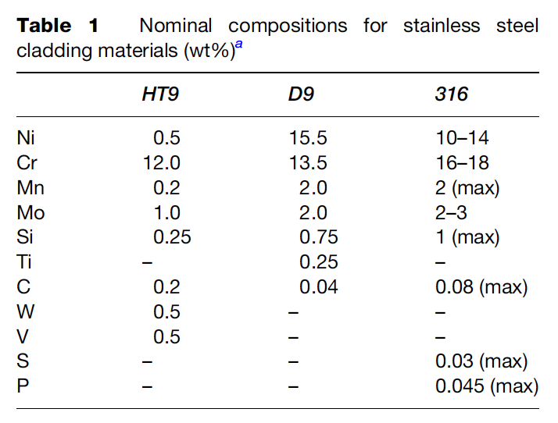
FCCI Compositions
Fe and Cr are the major constituents in HT-9 cladding and should show up as major constituents in the FCCI zones of irradiated HT-9-clad fuel elements
For D9-clad fuel elements, Fe, Ni, and Cr are major constituents that should be present in FCCI zones
There have been some irradiated fuel samples that were specifically destructively analyzed to observe FCCI
The lowest and highest determined temperatures at the fuel–cladding interface were 540 and 660 C, respectively
The thickest interaction zone measured was 170 μm, and the lanthanide fission products were the primary fuel constituents observed in the interaction layers

Slide 8
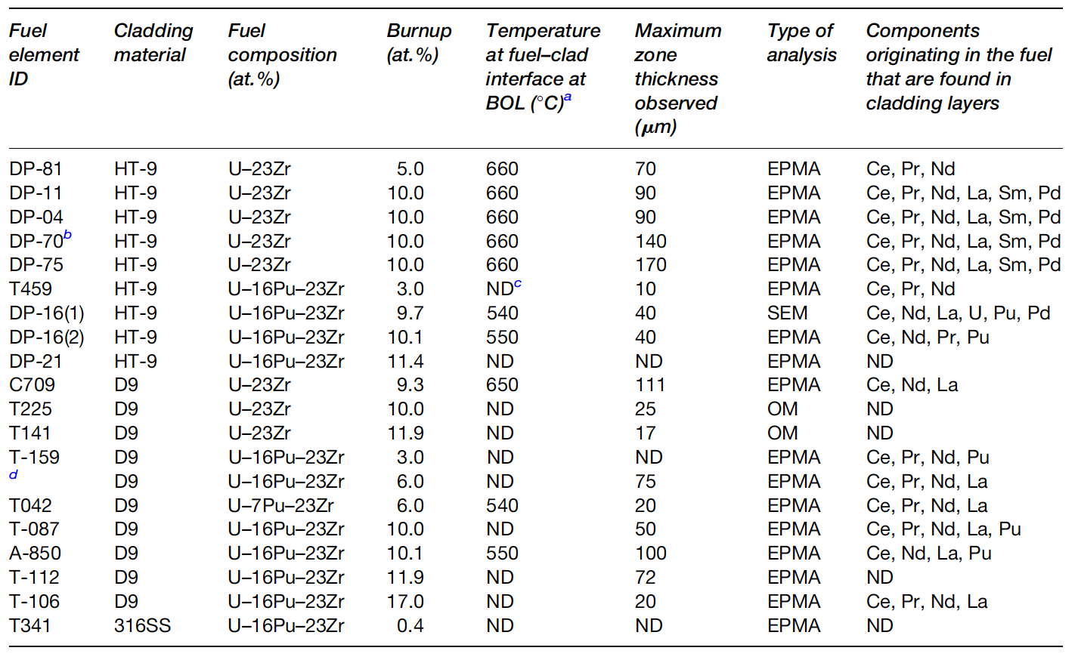
FCCI Examinations

Slide 9
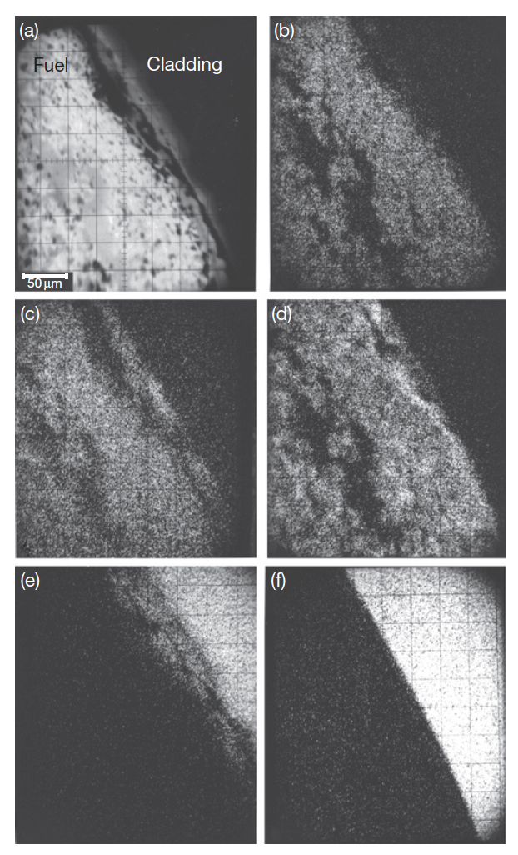
FCCI Compositions
Element DP-16 was the only fuel element in which a sample was generated for analysis using SEM/EDS, in addition to the more typical OM and EPMA analyses usually performed on fuel elements
U-16Pu-23Zr and HT-9 cladding
X-ray analysis maps at the right
(b) U, (c) Pu, (d) Zr, (e) Fe, (f) Cr

Slide 10
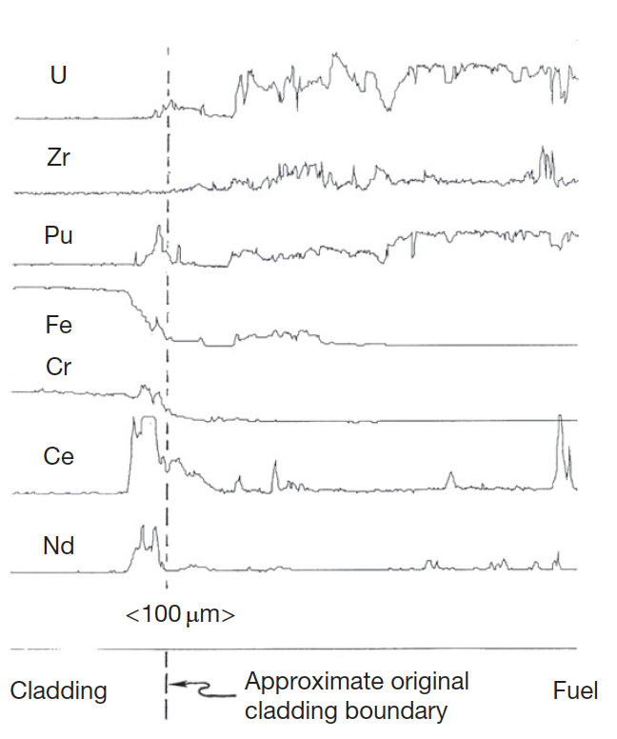
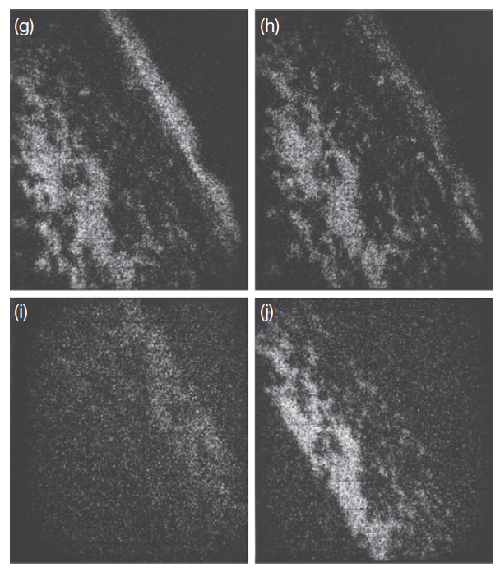
FCCI Compositions
X-ray map for fission products
EPMA analysis for key species
Fe diffuses into the fuel, Ce and Nd diffuse into the cladding, and Pd enriches in localized areas of the fuel near the fuel–cladding interface
The lanthanides penetrated the farthest into the cladding (40 mm) of any components originating in the fuel
(g) Ce, (h) Nd, (i) Ru, and (j) Pd

Slide 11
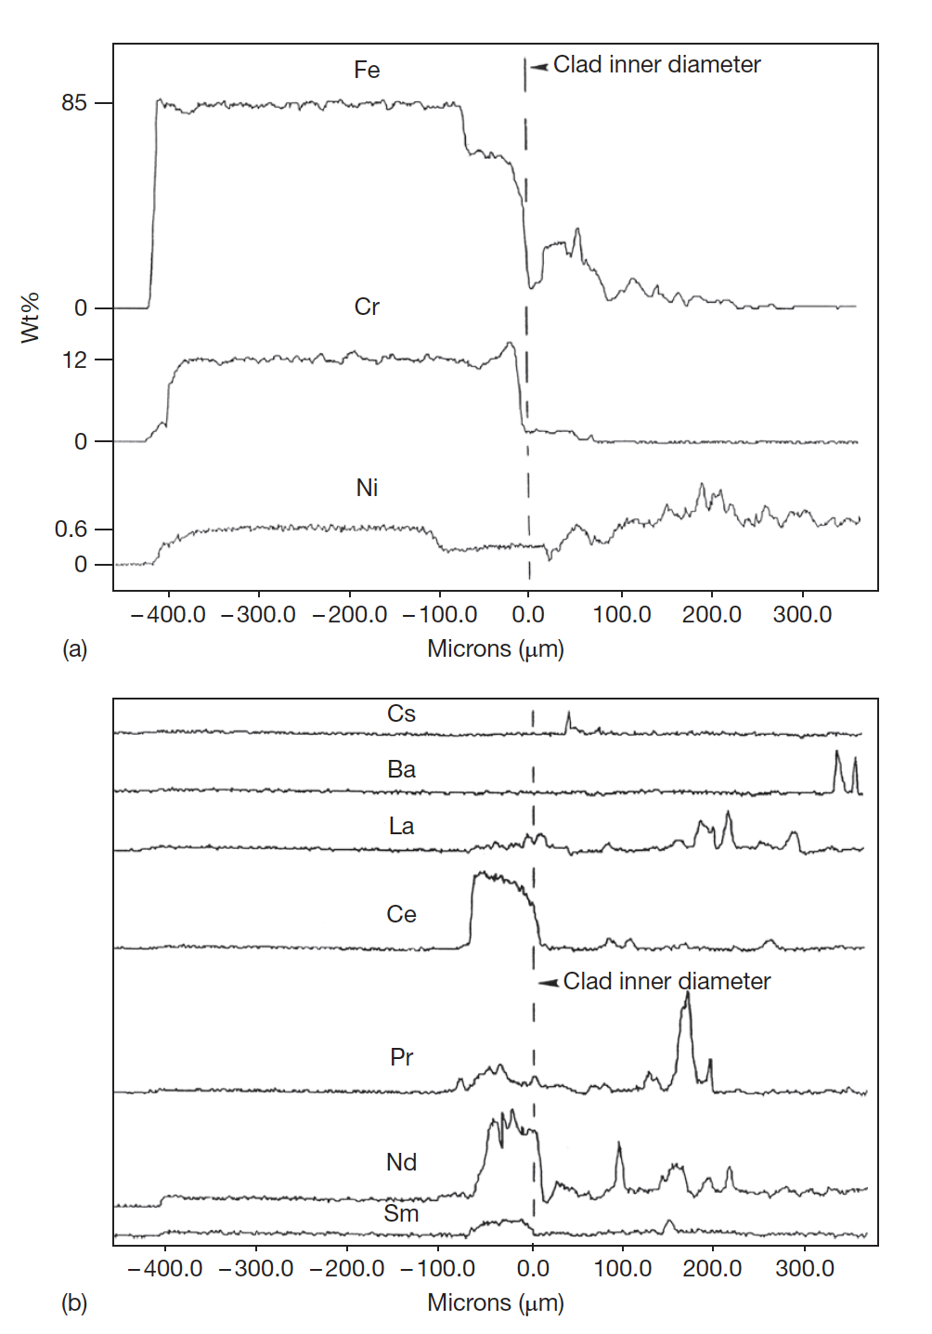
FCCI Compositions
The DP-11 fuel element was irradiated to about 10 at.% burnup at elevated cladding temperatures (630–660 C), binary U-Zr
There is a 50-μm-wide zone of the cladding that is high in Cr and low in Fe and Ni
In the fuel, Fe has interdiffused around 250 μm
In the cladding band containing high Cr and low Fe and Ni, lanthanide concentrations are elevated

Slide 12
FCCI
A variety of phases have been observed to form locally where swelled fuel has contacted the cladding
At the interface between the fuel and the cladding, the observed phases on both sides combine the cladding elements Fe, Ni, and Cr with the fuel components U, Zr, and Pu and the lanthanide fission products
In the cladding, the developed phases are enriched with cladding components, and they contain differing amounts of the primary fuel components and fission product components
Lanthanides penetrate farthest into the cladding, specifically Ce and Nd
Fe and Ni depletion zones are observed in all the fuel elements

Slide 13
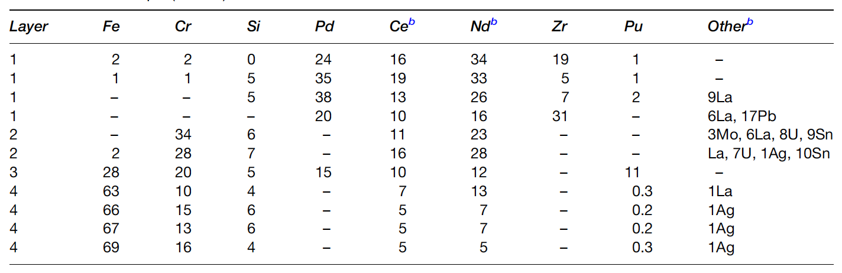
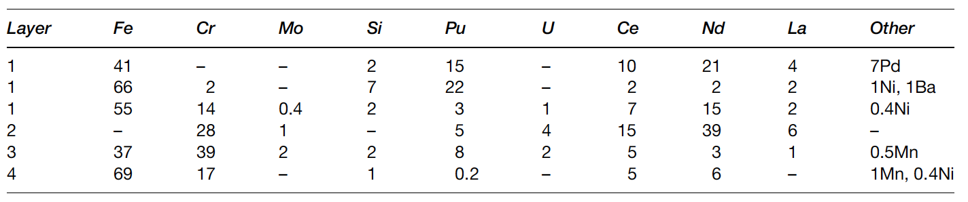
FCCI
In the fuel, some phases are observed that are enriched with the fuel constituents and contain Fe or Ni as the major nonfuel or components
Other phases are observed that primarily contain lanthanides
The interaction zone formation is localized
Temperature and power variations along the length of a fuel element appear to impact the amount of FCCI that occurs
Two different locations in DP-16

Slide 14
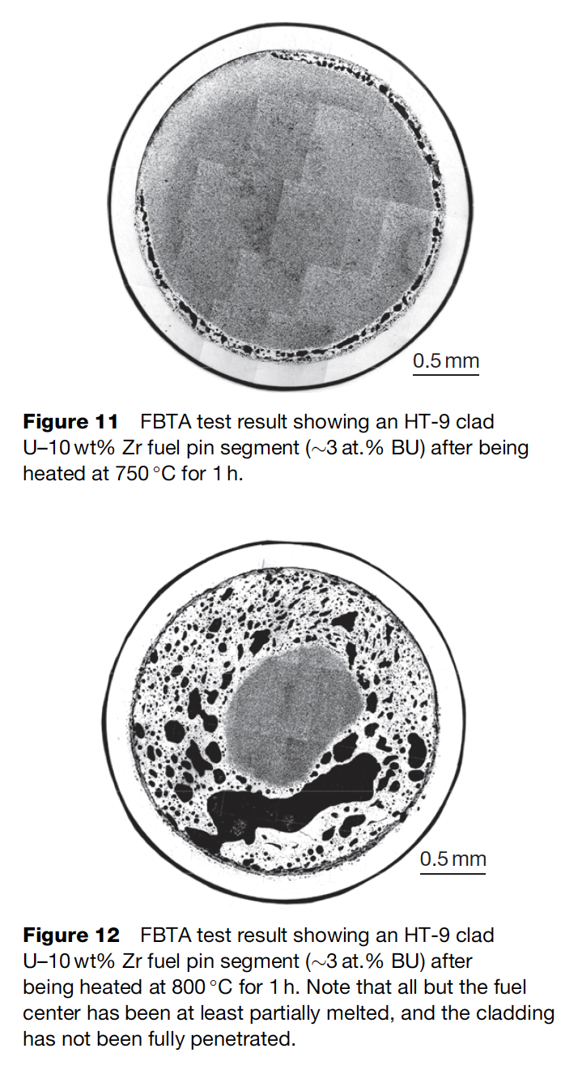
Melting Experiments
One potentially significant impact that the presence of FCCI zones is the melting of phases inside the cladding
This will limit the allowable coolant temperature that can be used for the reactor, but it can become more important when considering transients and accidents
This illustrates the effect of the relatively low quantities of Fe required to cause melting on the uranium-rich side of the U–Fe phase diagram
In general, no liquid phase formation is observed below heating at 700C

Slide 15
Metal fuel fabrication

Slide 16
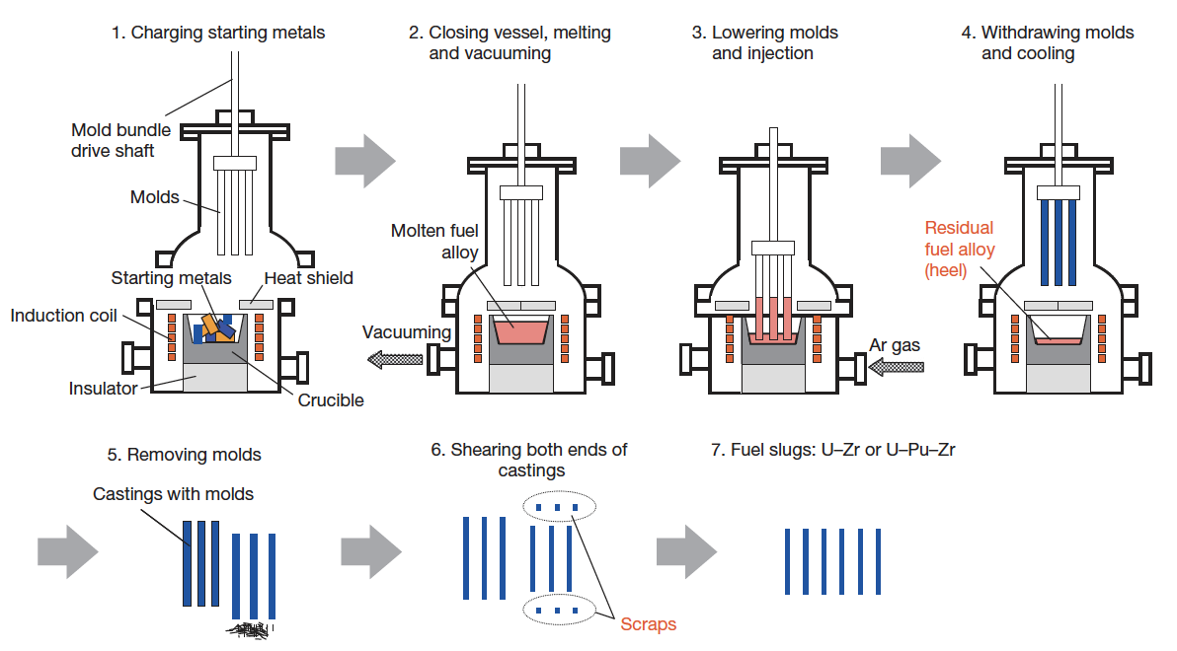
Metal Fuel Fabrication
Injection casting has been utilized for fuel slug fabrication
Remote fabrication has been performed inside a hot cell on recovered uranium
Fuel slugs for EBR II and FFTF were fabrication via injection casting

Slide 17
Metal Fuel Fabrication
Starting materials are charged into the graphite crucible in the furnace
Silica molds with tops closed are set above the crucible
Crucible is coated with yttria
Molds coated with zirconia

Slide 18
Metal Fuel Fabrication
Furnace closed and filled with Ar gas
Crucible is inductively heated to 1830K, and stirred electromagnetically
Ar gas removed, molds are lowered, then Ar gas returned
Pressure difference injects the melt into the molds

Slide 19
Reprocessing
Pyroprocessing
For more than 50 years, pyrometallurgy has been studied as an alternative strategy in the reprocessing of used fuel
Pyrochemical processes rely on refining techniques at high temperature (500–900 C) depending on the molten salt eutectic used
Typically, chloride systems operate at lower temperature compared to fluoride systems, and are preferred in processing
These processes are mainly based on electrorefining or on extraction from the molten salt phase into liquid metal
Two processes-one for oxide fuel and one for metallic fuel-have been developed to near industrial scale

Slide 20
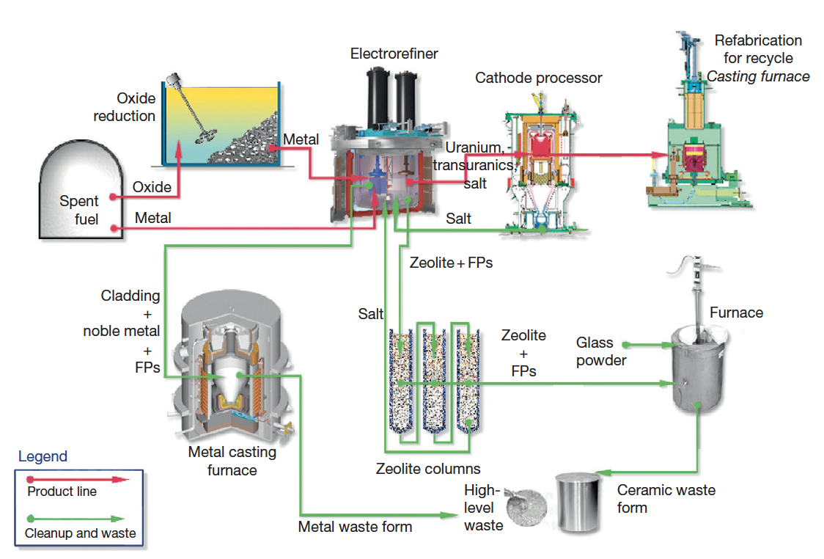
IFR Pyroprocess
This process was developed in the US to be part of the IFR project, and can handle the treatment of transuranics
The fuel is recycled using an electrochemical process based on molten chloride salts and liquid metals
The molten salt medium for electrorefining is a solution of a certain amount of UCl3 dissolved in a LiCl–KCl eutectic

Slide 21
IFR Pyroprocess
The fuel is electrochemically dissolved using a potential between the basket (loaded with used fuel) as anode and a stainless steel electrode in the salt as the cathode
Uranium and TRU are deposited on the cathodes
Once the fuel is dissolved and most of the uranium is deposited on the solid steel, this cathode is replaced by a liquid cadmium cathode, and the remaining TRUs can be co-deposited with the remaining uranium

Slide 22
IFR Pyroprocess
The alkali, alkaline earth, rare earth, and halide FPs remain primarily dissolved in the salt phase
More than 90% of the noble metal FPs and fuel alloy material are retained in the chopped fuel cladding segments in the anode baskets
Can reduce the repository burden of radioactive waste by separating long-lived MA from spent light-water reactor fuel, burning MA in fast reactors, and decreasing the long-term radioactivity of nuclear waste

Slide 23
Refabrication
Metal-fueled fast reactors facilitate the effective transmutation of MA because of the high-energy neutron spectrum
One of the measures to load MA into the reactor core is to add MA to the fuel alloy homogeneously
Can perform injection casting in the same manner as the fresh fuel, to form MA-bearing fuel alloys
These technologies are expected to reduce the fuel cycle cost even for small-scale fuel cycle plants because of the simplicity of the process and the compactness of the equipment
For example, in the injection casting process, composition adjustment, melting (alloying), and casting of the fuel slug can be done in a single injection-casting furnace

Slide 24
Metallic fuel performance modeling

Slide 25
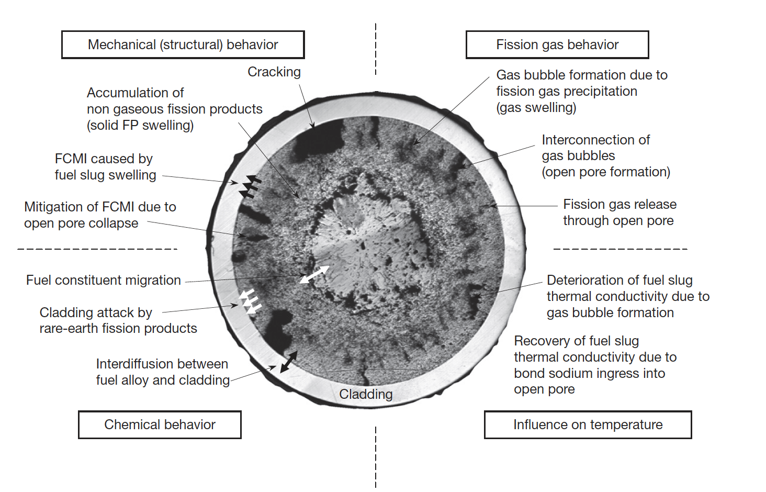
Metallic Fuel Phenomena

Slide 26
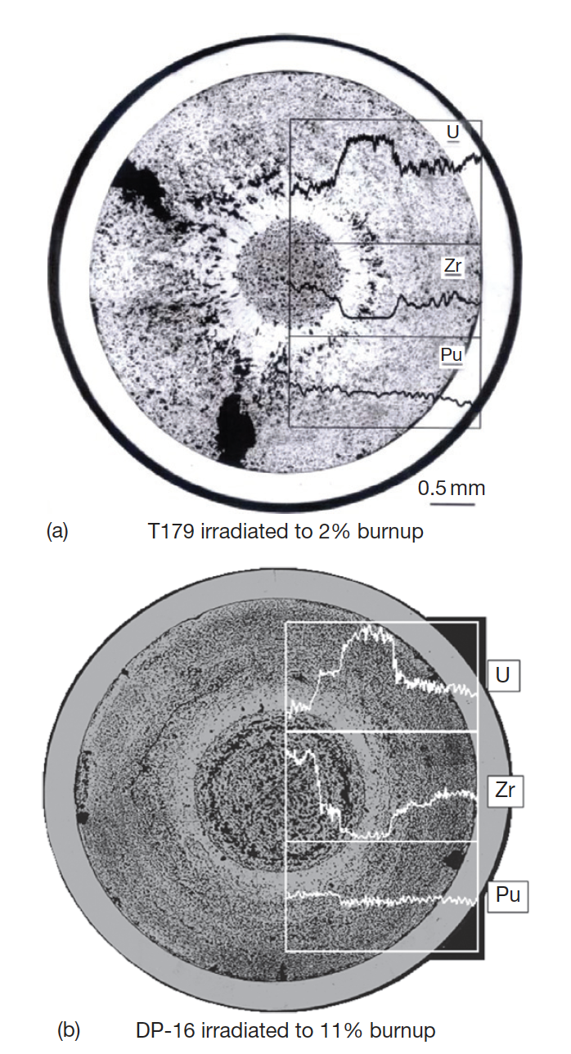
Constituent Redistribution Models
Constituent redistribution is driven by:
temperature gradients in the fuel,
solubility gradients in a phase and phase boundaries,
additional chemical potentials applied by fuel– cladding gap and cladding
Results in three concentric zones, namely, a Zr-enriched central zone, a Zr-depleted and U-enriched intermediate zone, and a slightly Zr-enriched zone on the outer periphery
Migration quickly levels off early in life after a new distribution settles

Slide 27
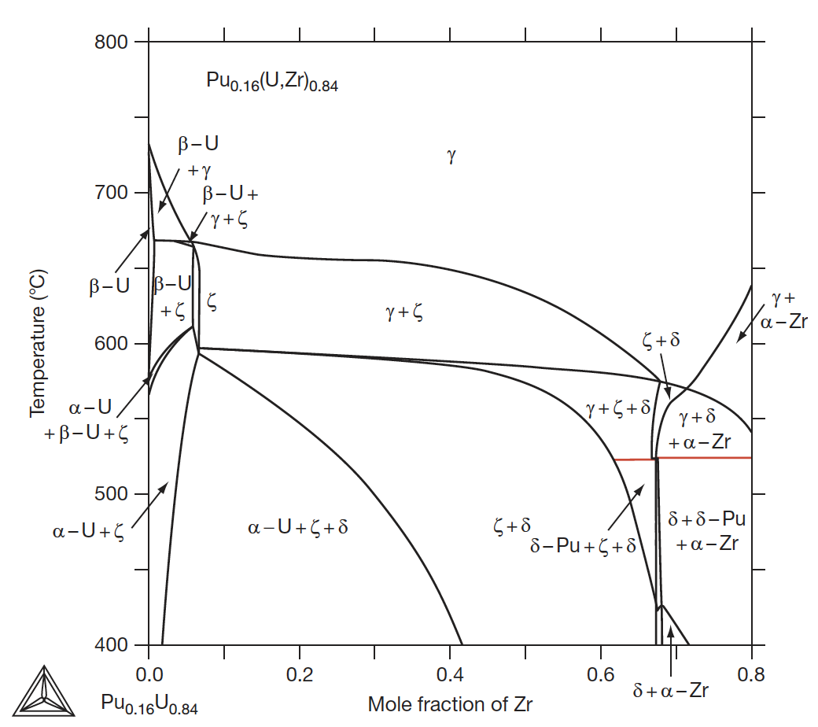
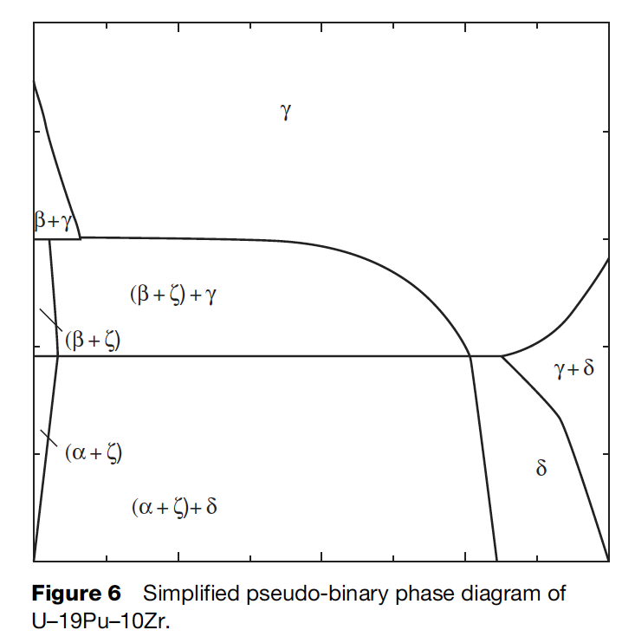
Constituent Redistribution Models
While ternary phase diagrams exist, their accuracy is suspect, and simplified pseudo-binary phase diagrams can be more easily implemented, and removes complexities associated with largely unknown phases
When applied to a fuel with different Pu content, the phase diagram must be modified accordingly

Slide 28
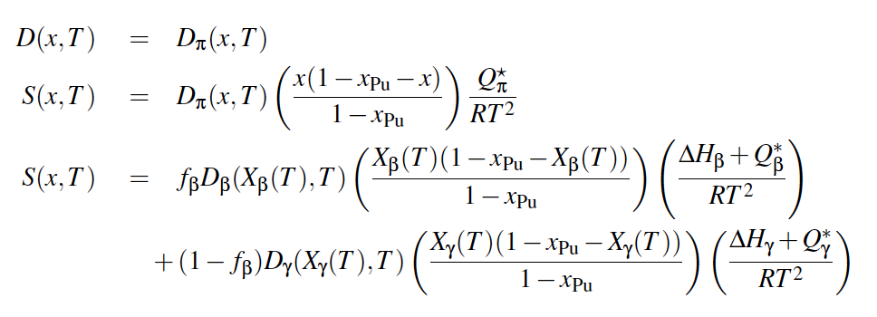
Constituent Redistribution Models
Using the calculated phase fractions, the Fickian and Soret diffusion coefficient are determined
Artificial factors are used to set the diffusivity in two-phase regions and to scale diffusivities in each phase
The magnitudes of diffusivities in each phase are largely unknown, and effectively wholly unknown in two-phase regions
BISON Zr Diffusion Model

Slide 29
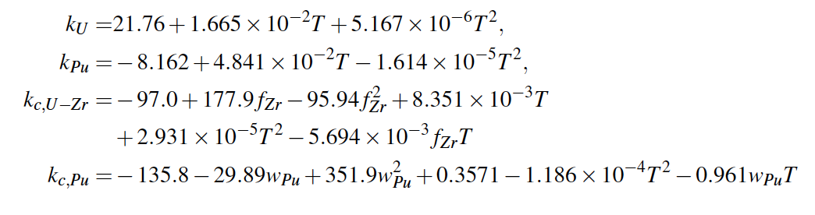
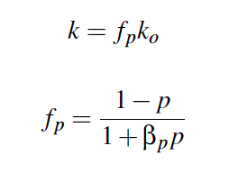
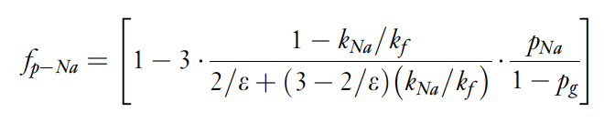
Temperature Predictions
Constituent redistribution relies on accurate temperature profiles
Fuel temperature is affected by the thermal conductivity of the fuel, which in turn is changed by porosity evolution and sodium infiltration, in addition to changes in Zr concentration
BISON thermal conductivity models exist for the distinct phases/species, and account for degradation of thermal conductivity

Slide 30
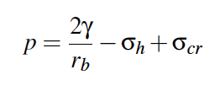
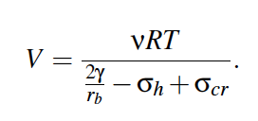
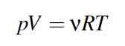
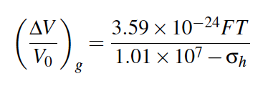
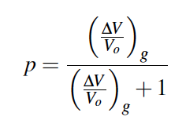
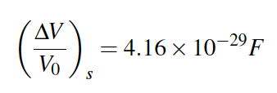
Porosity Predictions
BISON utilizes a simplified model for porosity
The mechanical force balance on an equilibrium bubble can be expressed by the Young-Laplace equation
Making assumptions for creep stress, bubble size, can calculate swelling due to fission gas
Finally, can determine porosity from the swelling
Solid fission products are a function of fission density

Slide 31
Porosity Predictions
These porosity models don’t incorporate different phases, initial porosity, axial/radial swelling, etc.
These models have been updated slightly to improve code robustness, but still don’t incorporate these critical microstructural phenomena

Slide 32
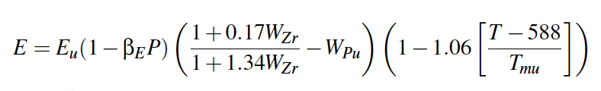
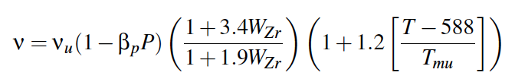
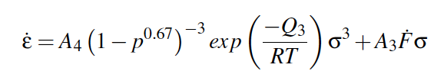
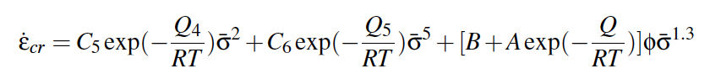
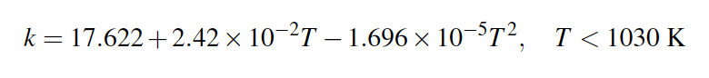
Mechanical Properties
Young’s Modulus
Poisson’s ratio
Creep
Cladding models for HT-9 creep and k_{th}

Slide 33
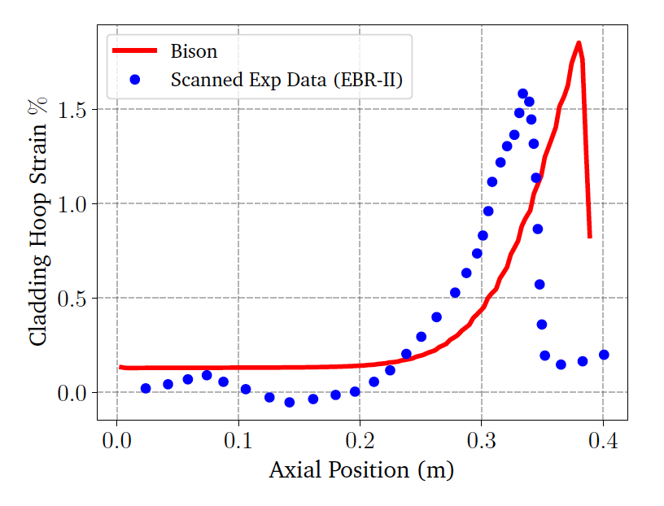
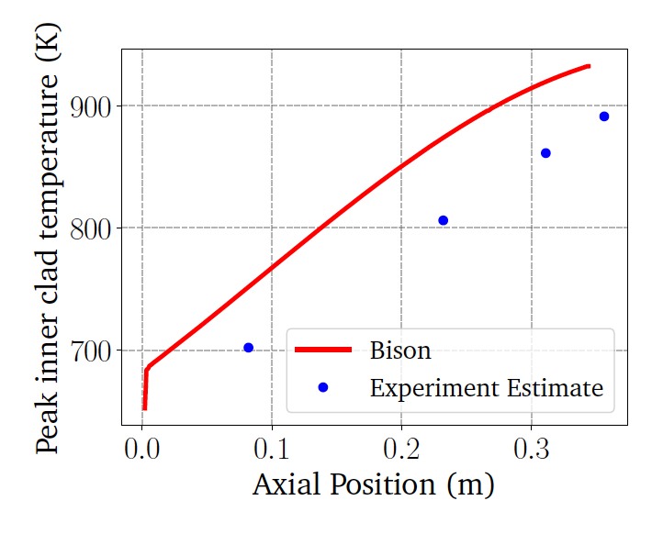
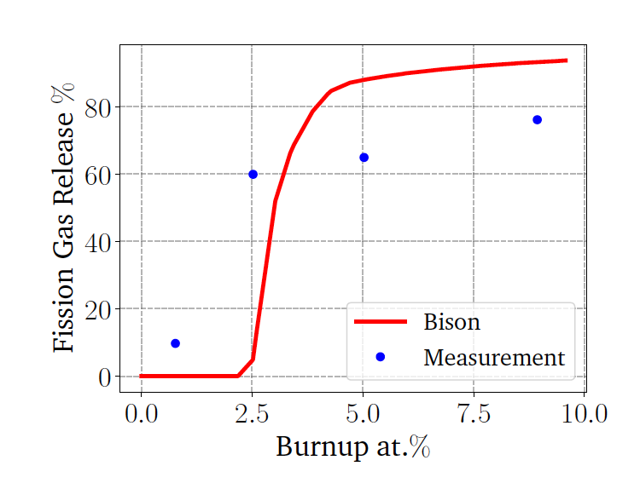
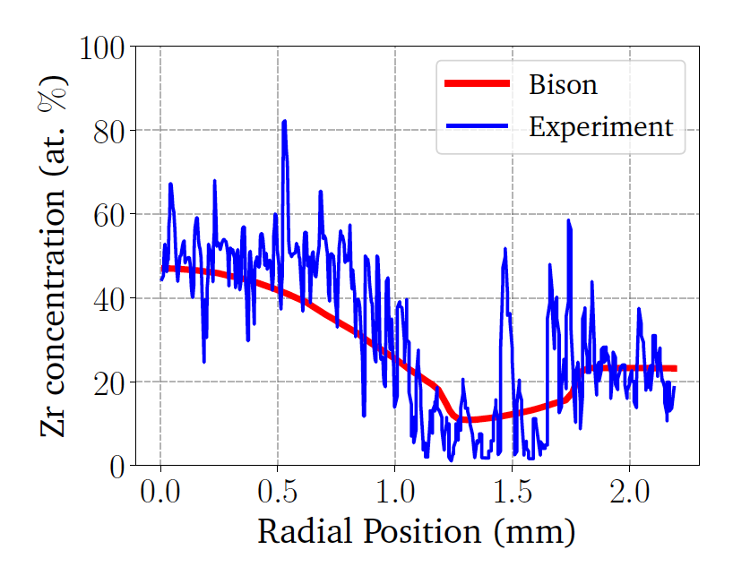
BISON Testing
BISON can handle binary and ternary fuel and compare reasonably well with EBR-II data
Discrepancies are due to inadequate knowledge of materials models, and underlying issues with material descriptions, and code robustness
Development is ongoing, and improvements to swelling models, for example, have been made

Slide 34
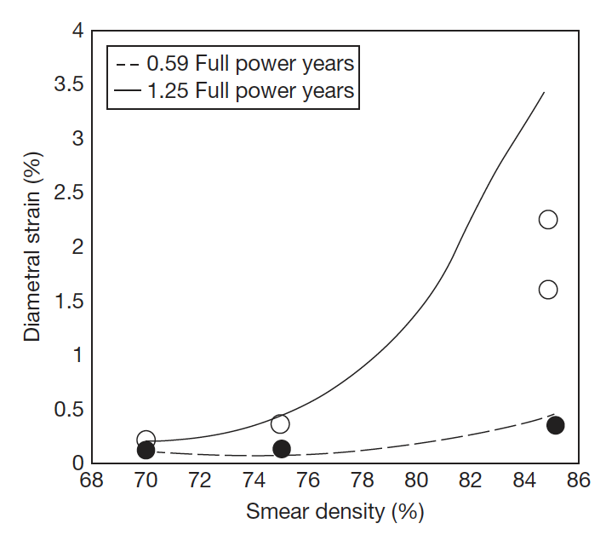
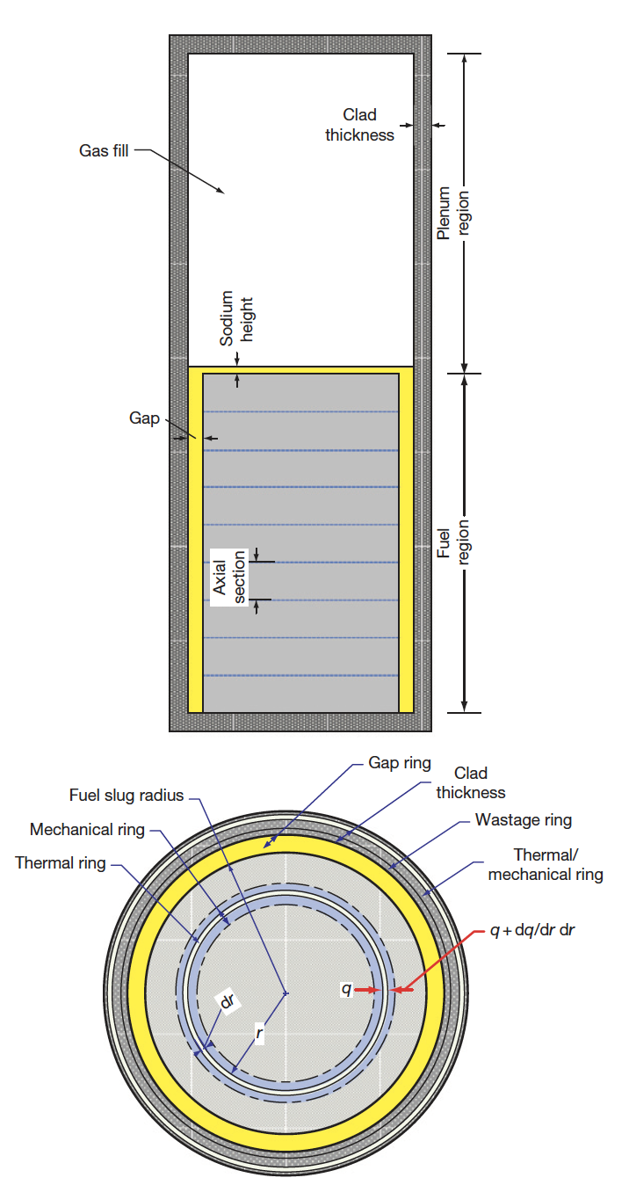
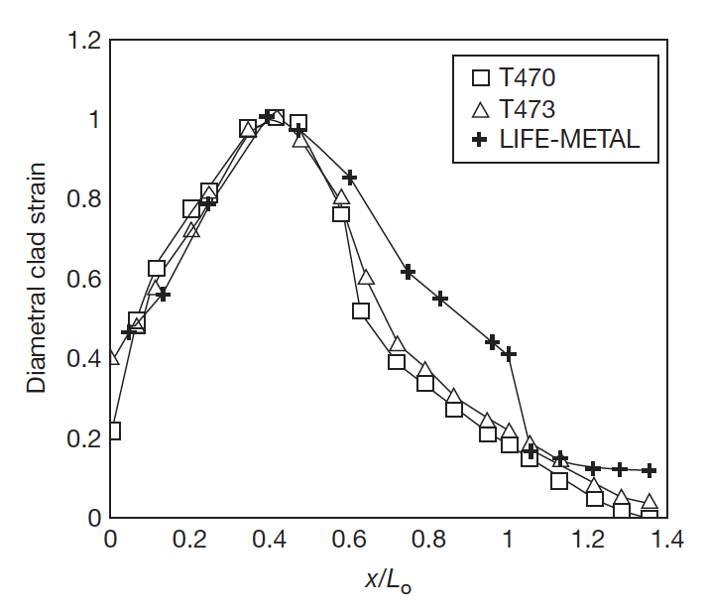
Other Codes
LIFEMETAL
The code has evolved from the LIFE series of codes from ANL that perform steady-state and transient analyses for nuclear fuel
The original code was developed for UO2 and mixed oxide fuels for use in fast reactor systems
The code was developed in association with the IFR and has been extensively used for planning steady state and transient experiments at EBR-II

Slide 35
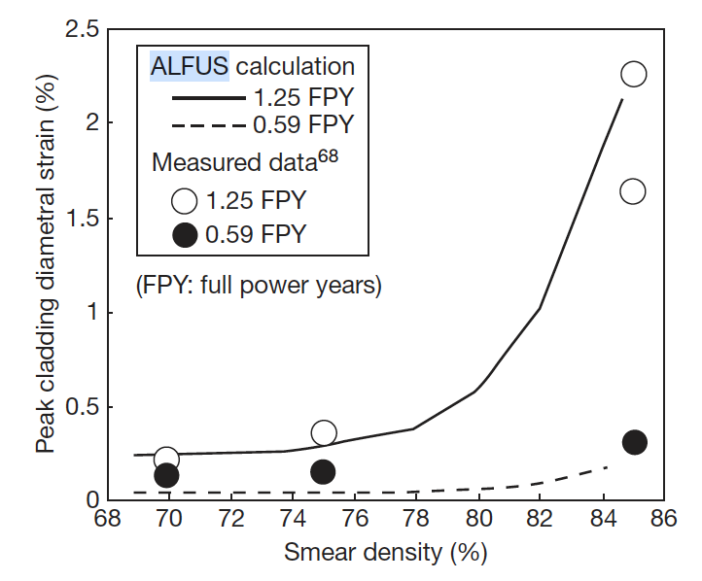
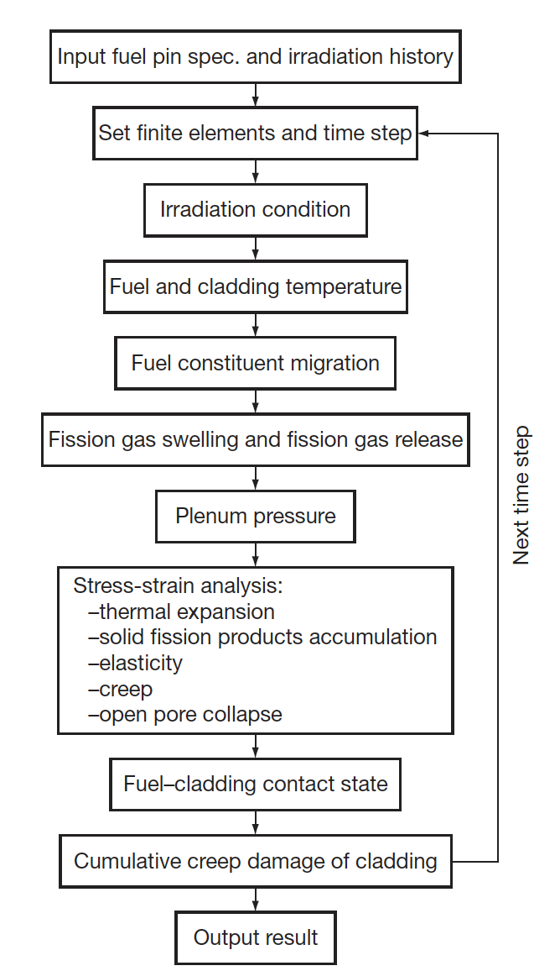
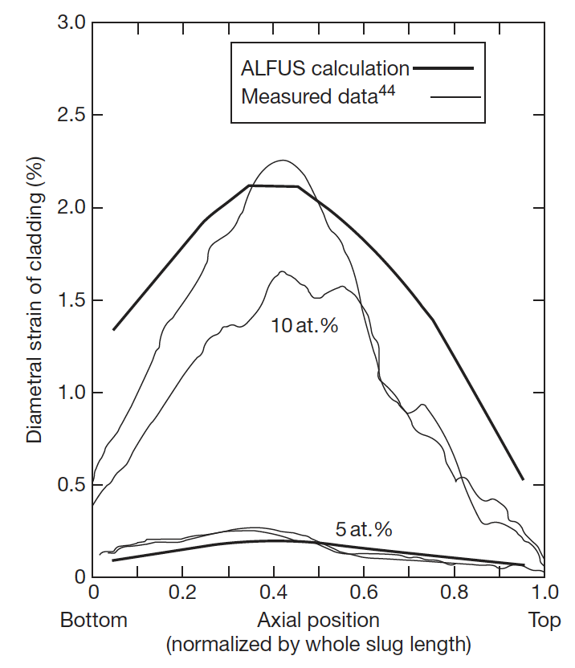
Other Codes
ALFUS
JAEA code that is multiphysics in nature and focuses on the mechanical behavior of the fuel under irradiation
Both LIFE-METAL and ALFUS are capable of simulating metal fuel irradiation behavior to some extent
Both lack different swelling in different radial zone, coupling of redistribution, realistic predictions of FCCI

Slide 36
Questions?

